Slide 1


Object-Oriented Programming Case Study
Hall Booking
Management System
A Java Desktop GUI Application by Hall Symphony Inc.
Submitted By:
Aakash Subedi (NP070062)
Abdul Rahman Kawari (NP070082)
Mimi Shrestha (NP070232)
Rabin Bista (NP070294)
2026
Java Swing
4 User Roles
Submitted To:
Ishan Shrestha (Module Lecturer)

Slide 2
Overview
Table of Contents
01
Introduction
02
Design Solutions
System overview and specifications
UML diagrams and architecture
03
Use Case Diagram
04
Class Diagram
Actor interactions and system functionality
Model layer structure and relationships
05
Program Output Screenshots
06
Object-Oriented Concepts
User interface demonstrations
OOP principles implementation
07
Additional Features
08
Limitations and Conclusion
Enhanced functionality
System constraints and final assessment

Slide 3
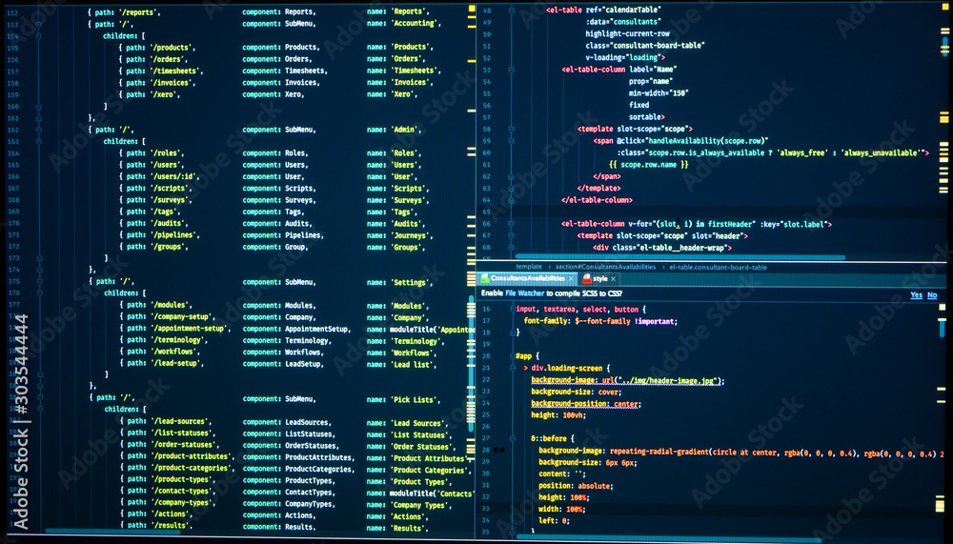
01
Introduction
Overview of the Hall Booking Management System

Slide 4
1.1 System Overview
Hall Booking Management System
Application Type
User Roles
A Java desktop GUI application developed by Hall Symphony Inc, supporting four distinct user roles with separate dashboards and role-specific features.
Customer
Scheduler
Administrator
Manager
Technology Stack
Hall Types & Operating Hours
GUI Framework: Java Swing
Auditorium (1,000 seats)
RM 300/hr
Data Storage: Plain text files (CSV format)
Banquet Hall (300 seats)
RM 100/hr
Architecture: Object-Oriented Design
Meeting Rooms (30 seats)
RM 50/hr
Operating Hours: 8:00 AM - 6:00 PM Daily

Slide 5
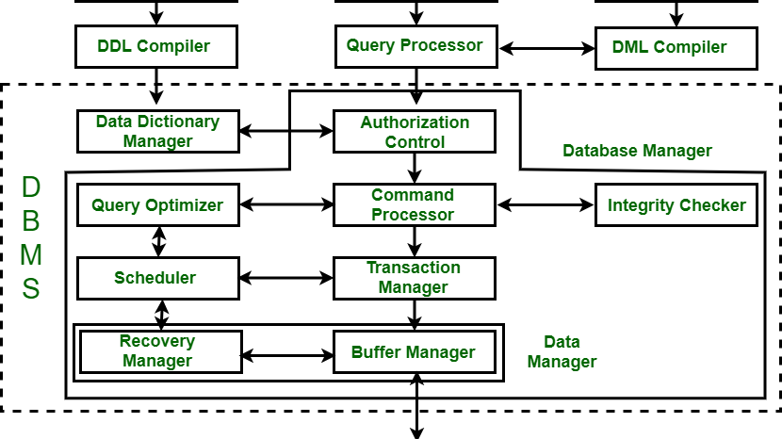
02
Design Solutions
UML Design and System Architecture

Slide 6
2.1 Use Case Diagram
System Interactions and Actor Roles
Scheduler
Administrator
• Monitor hall records
• Scheduler Management: Add, view, filter, edit, delete
• Set hall availability schedules
• Customer Management: View, filter, block/delete
• Set maintenance schedules
• Booking Overview: View all bookings
• Manage assigned issues
• Report Generation: Summary reports
Customer
Manager
• Register account & login
• Sales Dashboard: Weekly/monthly/yearly views
• Make bookings with payment
• Maintenance Operations: View & manage
• View receipts & booking history
• Issue Management: View customer issues
• Cancel bookings (3 days prior)
• Response & Assignment: Respond & assign to Scheduler
• Update profile & raise issues
• Status Changes: Update issue status

Slide 7
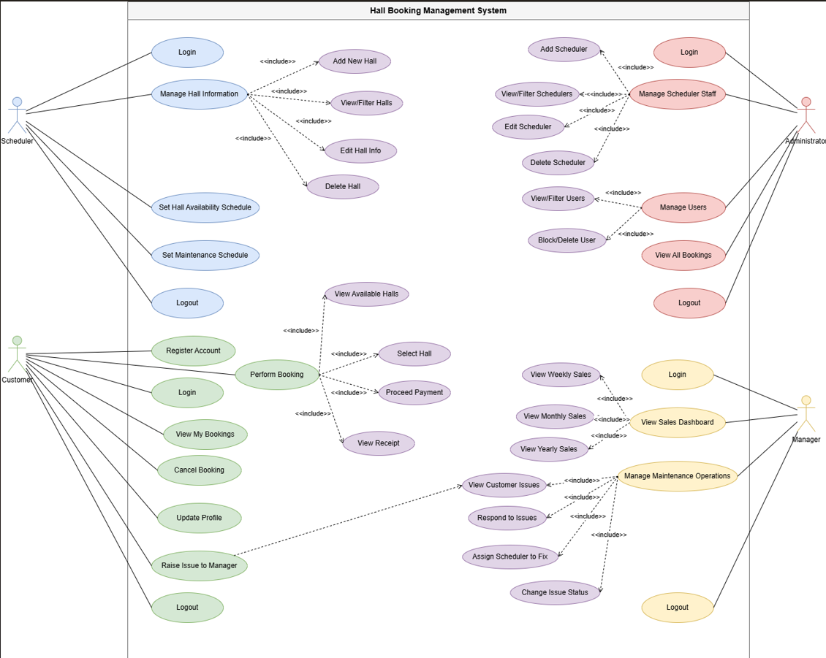
2.2 Use Case Diagram Visualization
Use Case Diagram
Figure 1: Use Case Diagram showing system interactions between four user roles and the Hall Booking Management System

Slide 8
2.3 Class Diagram
Model Layer Structure
Abstract Base Class
User Subclasses
User
Customer
Abstract base class
Defines common attributes and methods for all user types. Cannot be instantiated directly.
Scheduler
Administrator
Core Business Objects
Manager
Hall
Booking
Payment
Utility Package
FileManager
Issue
Schedule
File I/O operations
Used by all GUI classes for data persistence

Slide 9
2.4 Class Relationships
Object Relationships and Associations
Inheritance
One-to-One
User
Booking
Payment
Customer
Scheduler
One Booking generates exactly one Payment
Administrator
Manager
"Is-a" relationship: All subclasses inherit from User
Zero-to-Many / Zero-to-One
Customer
Issue
One-to-Many
Customer raises zero or many Issues
Customer
Booking
Issue
Scheduler
A Customer can have multiple Bookings
Issue assigned to zero or one Scheduler
Hall
Booking
A Hall can host multiple Bookings
Schedule Records
Hall ↔ Schedule: Schedule records track Hall availability and maintenance periods

Slide 10
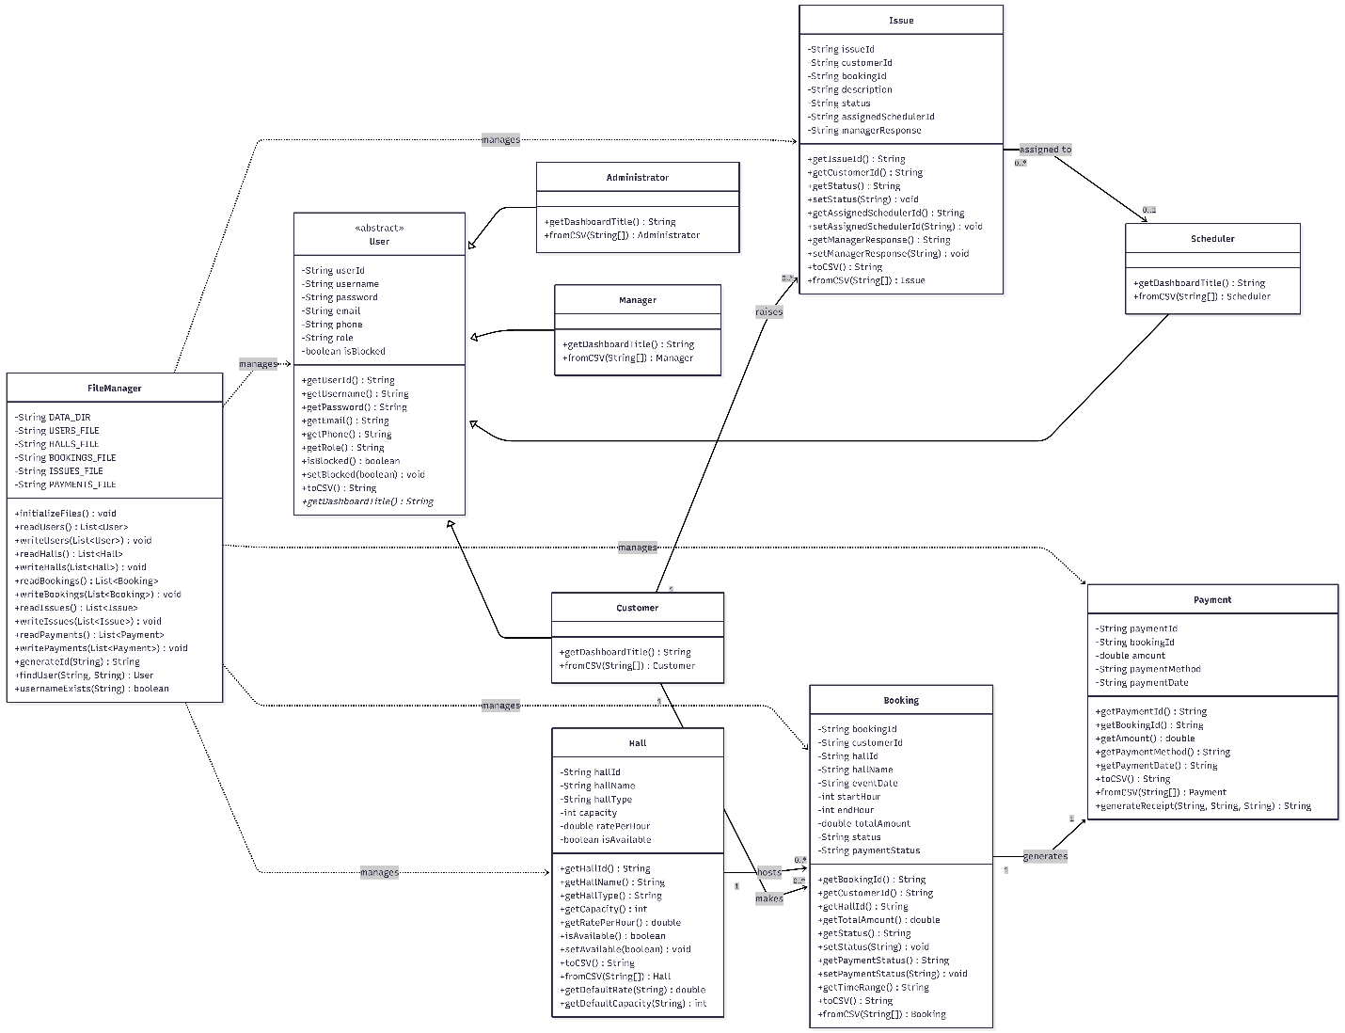
2.5 Class Diagram Visualization
Class Diagram
Figure 2: Class Diagram showing the complete Model Layer structure with inheritance, associations, and relationships

Slide 11

03
Program Output
Screenshots
User Interface Demonstrations

Slide 12
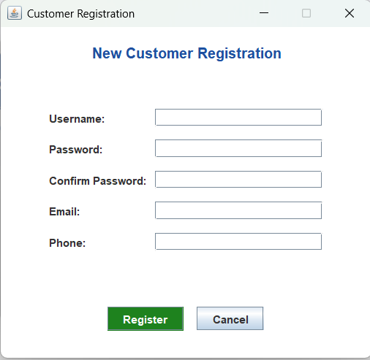
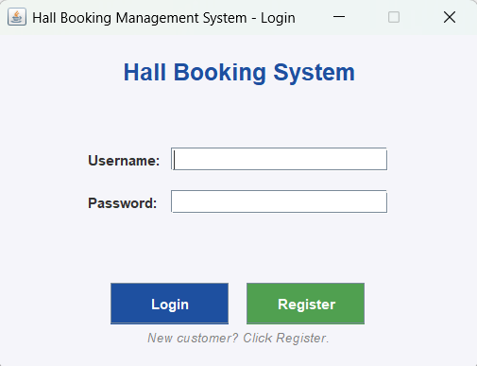
3.1 Authentication Screens
Login and Registration
Login Screen Features
Registration Features
• Single entry point for all four user roles
• New customer account creation
• Username and password authentication
• Complete field validation
• Error dialogs for incorrect credentials
• Duplicate username checking
• Blocked account denial with proper messages
• Account saved to users.txt

Slide 13
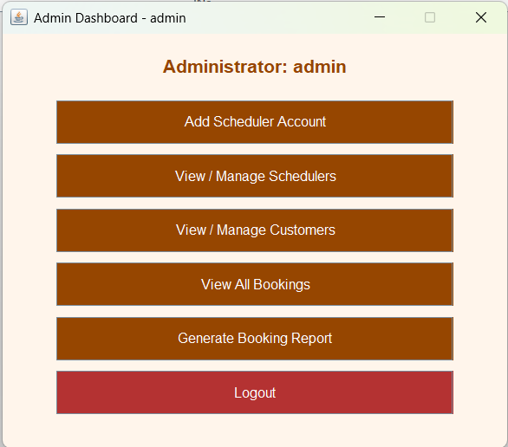
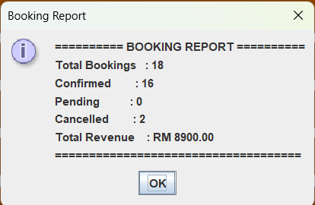
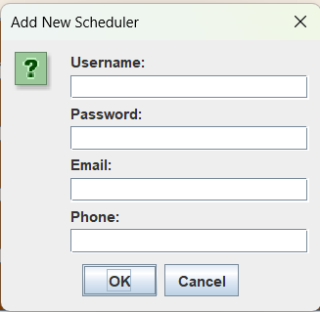
3.2 Administrator Interface
Administrator Dashboard
Admin Functions
• Create Scheduler accounts
• Block/unblock users
• View all bookings
• Generate summary reports

Slide 14
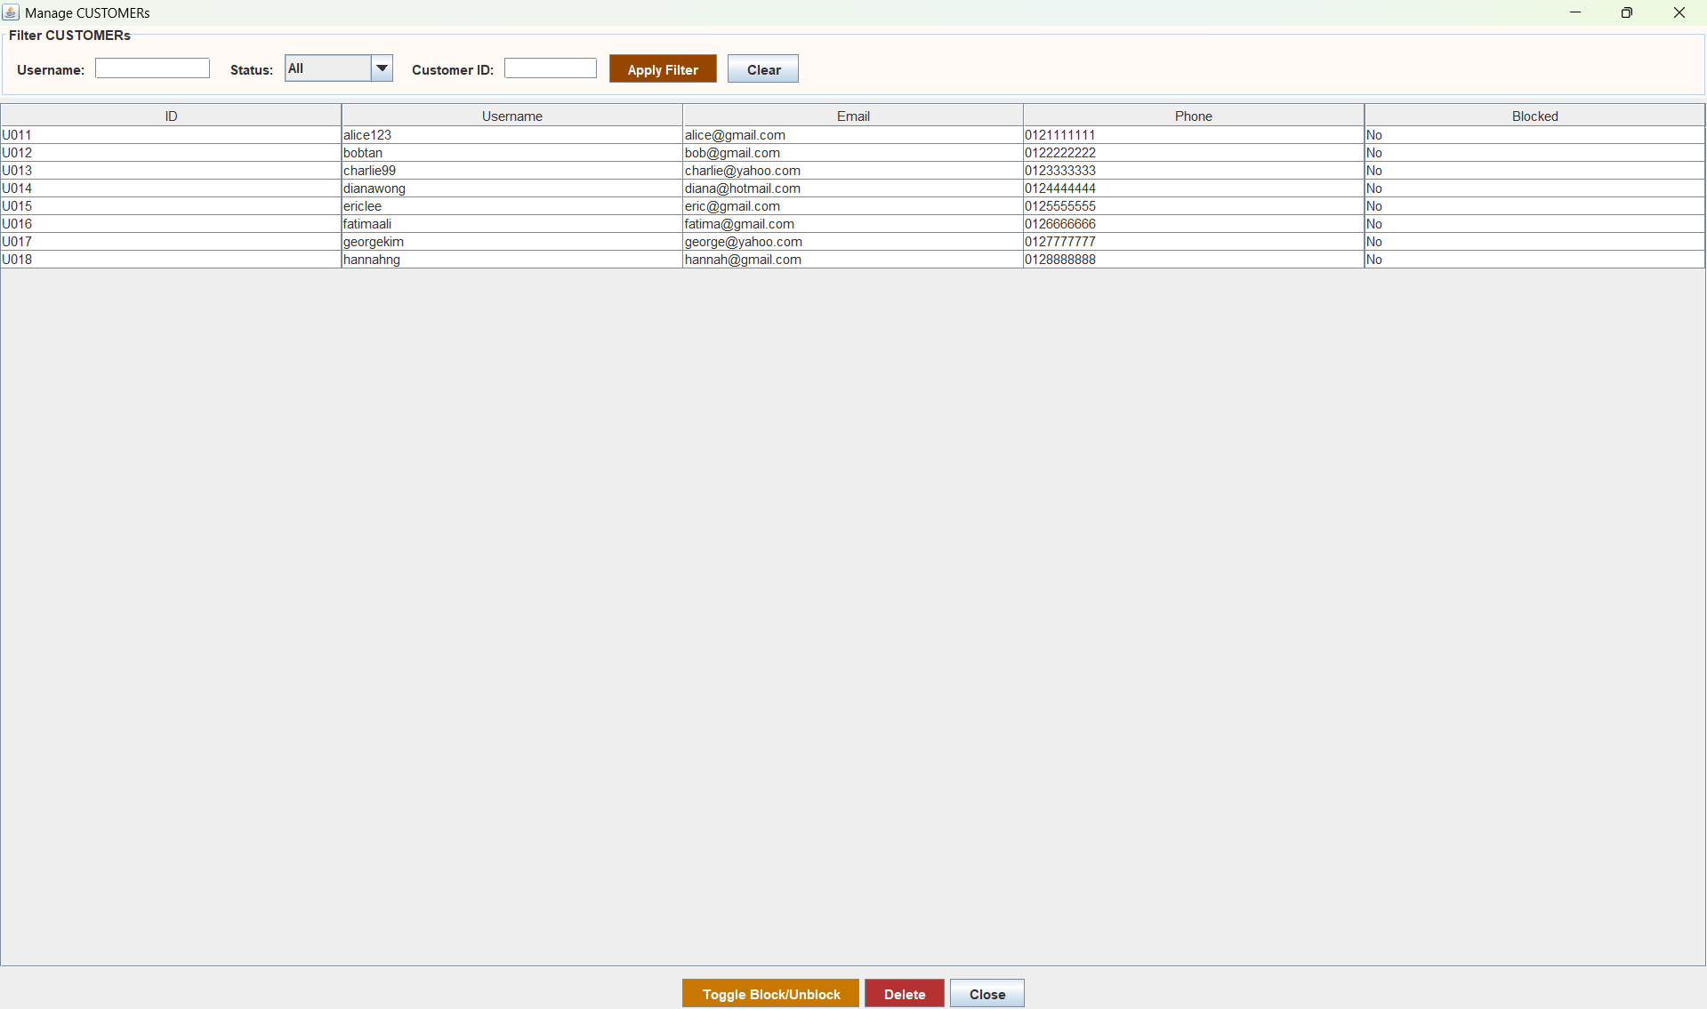
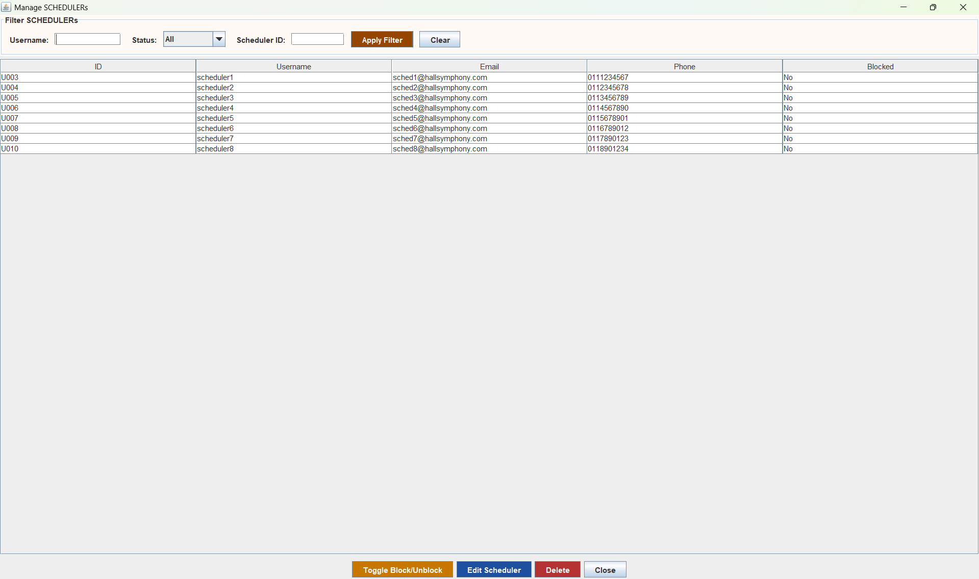
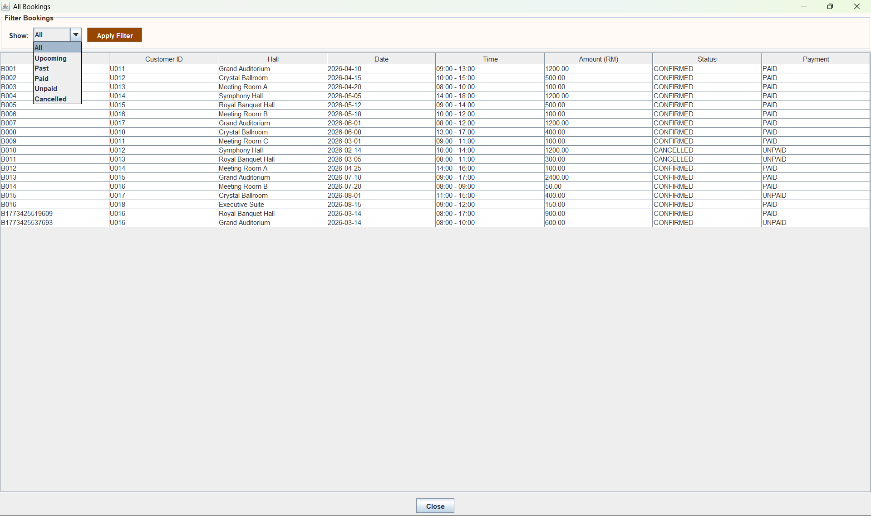
3.2 Administrator Interface
Administrator Dashboard

Slide 15
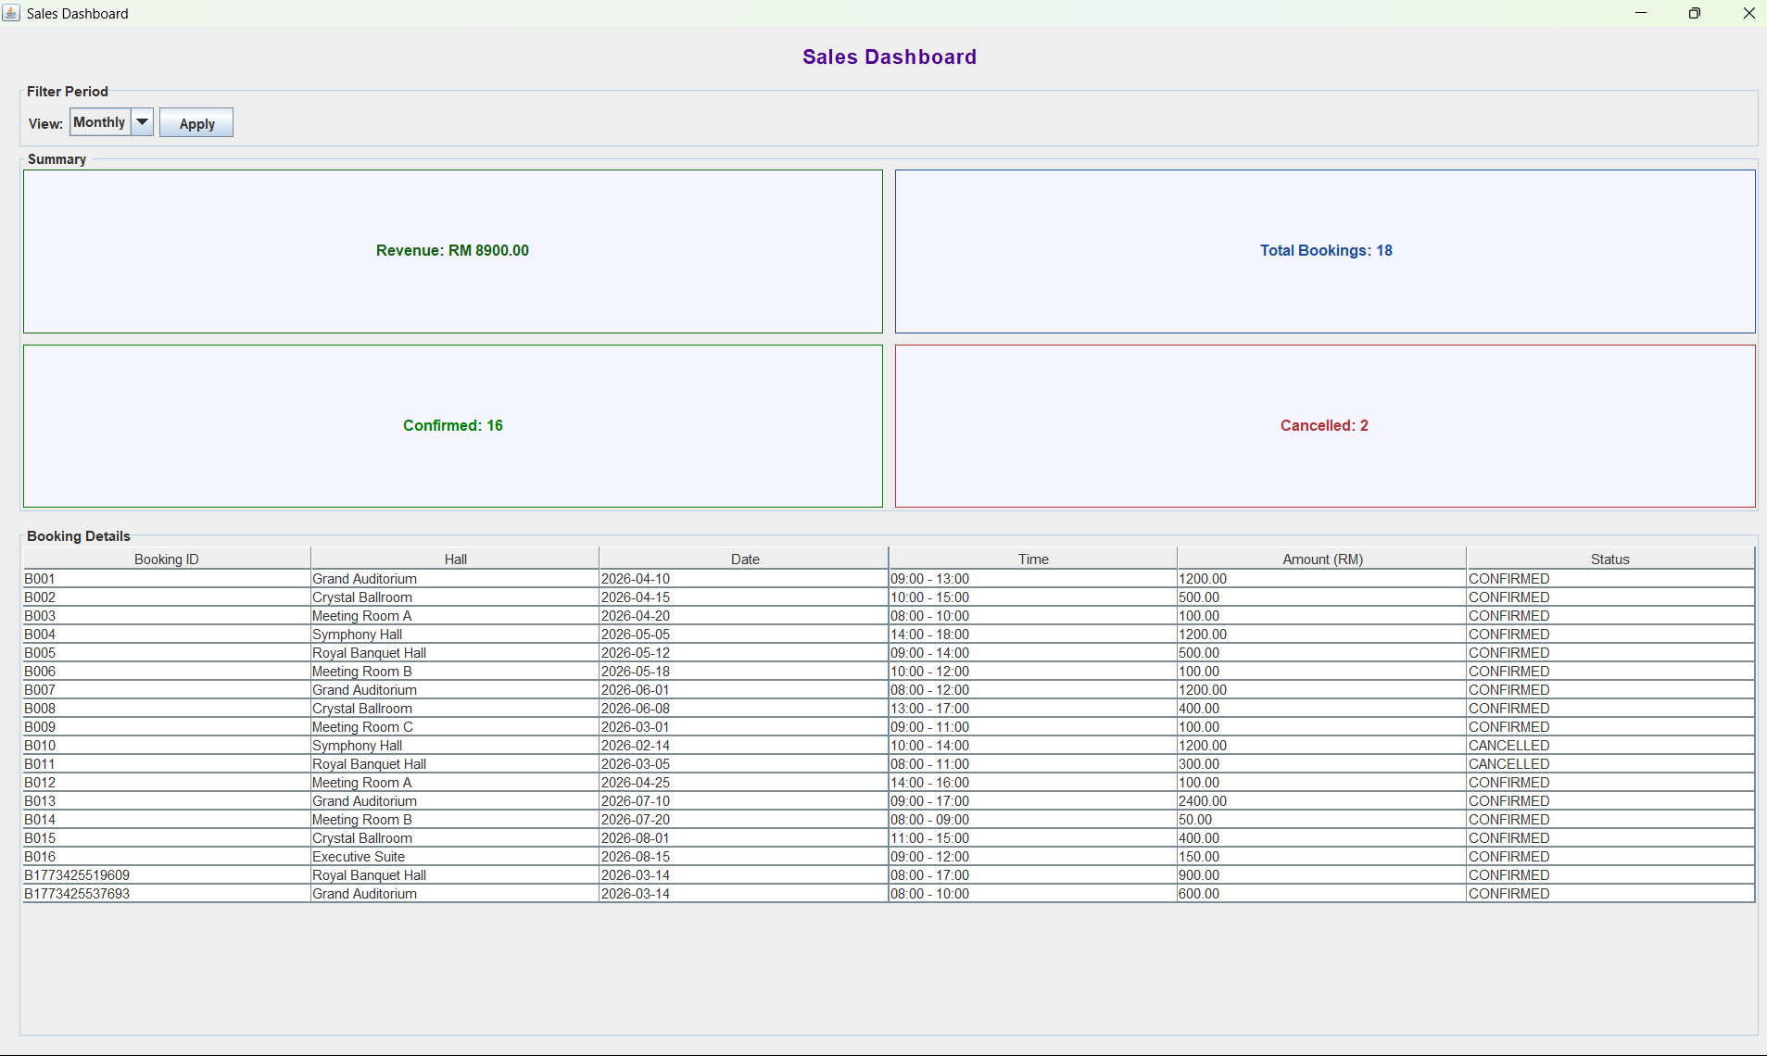
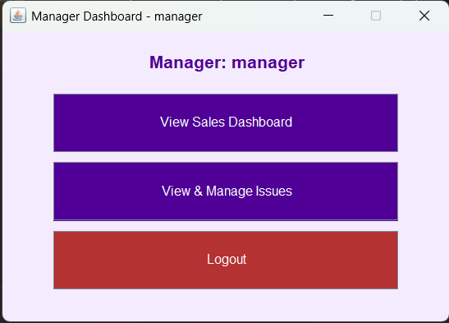
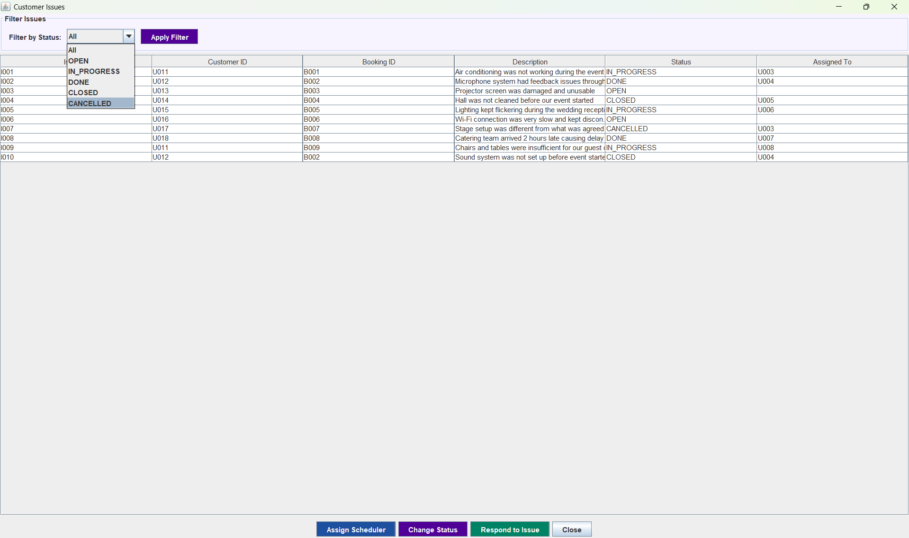
3.3 Manager Interface
Manager Dashboard
Manager Capabilities
• Sales Dashboard: View booking revenue by week/month/year
• Issue Management: View all customer issues with status
• Response System: Respond to customer issues
• Assignment: Assign issues to Scheduler
• Status Workflow: OPEN → ASSIGNED → IN_PROGRESS → DONE → CLOSED/CANCELLED

Slide 16
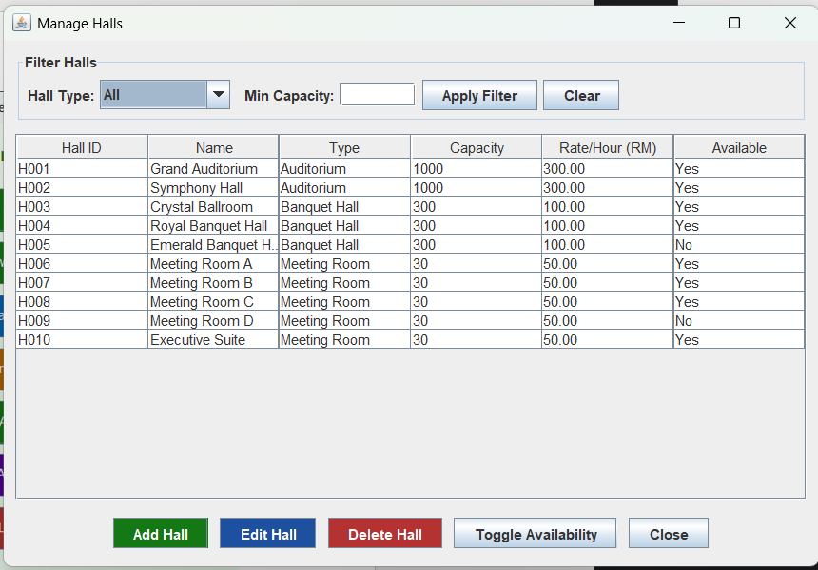
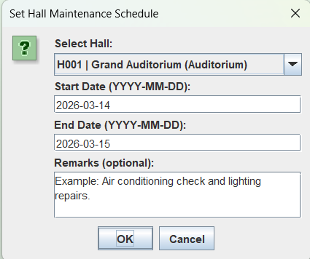
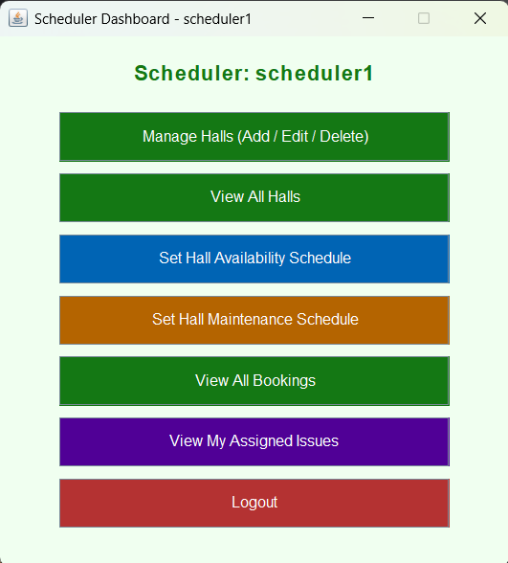
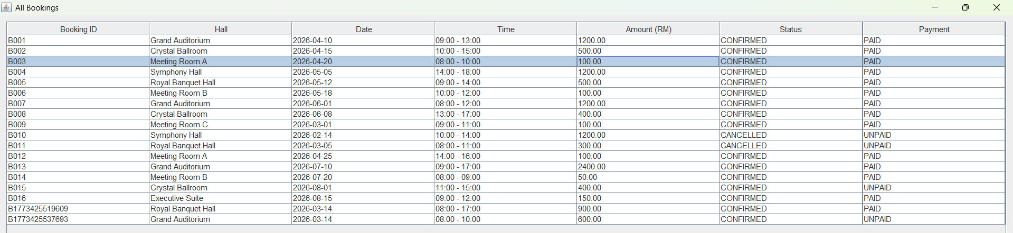
3.4 Scheduler Interface
Scheduler Dashboard
Note: Scheduler can set start/end dates and times with optional remarks for both availability and maintenance
Scheduler Functions
• Hall Management: Add, edit, delete halls
• Availability: Set hall availability periods
• Maintenance: Schedule maintenance windows
• Booking View: View all customer bookings
• Issue Tracking: Track assigned issues

Slide 17
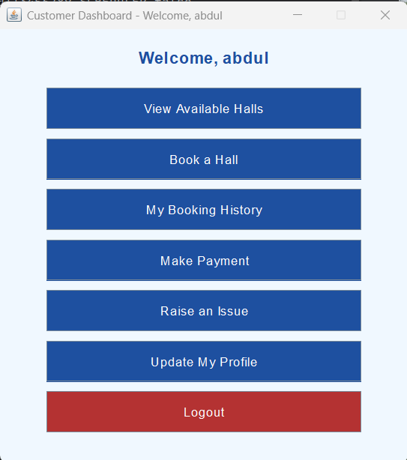
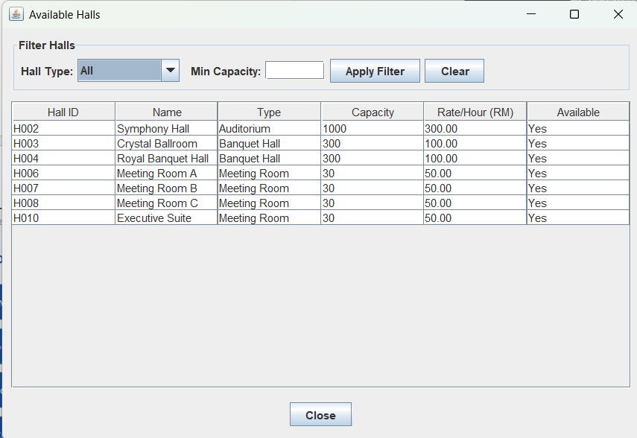
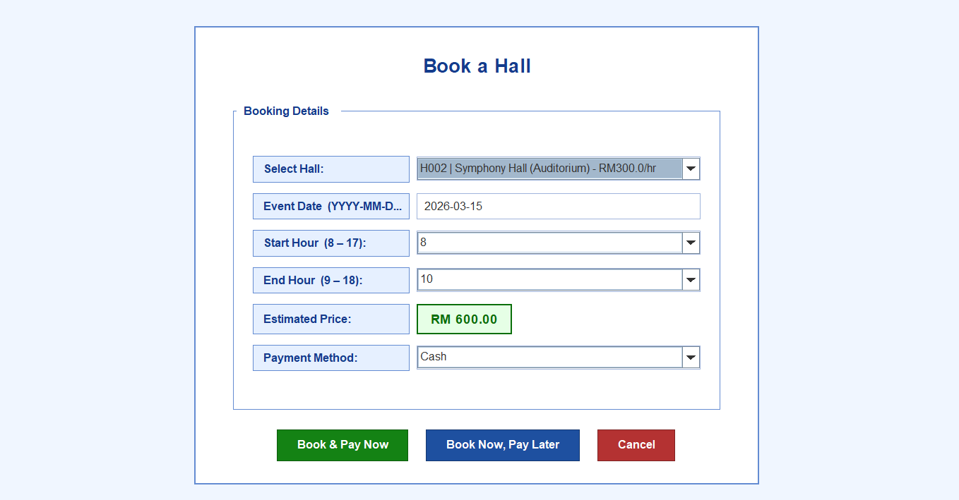
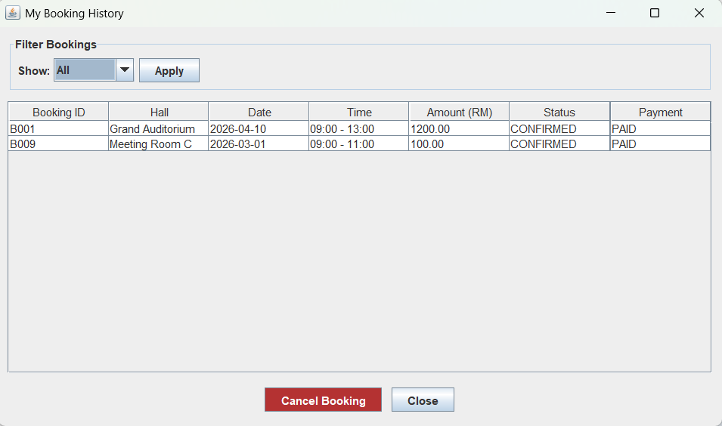
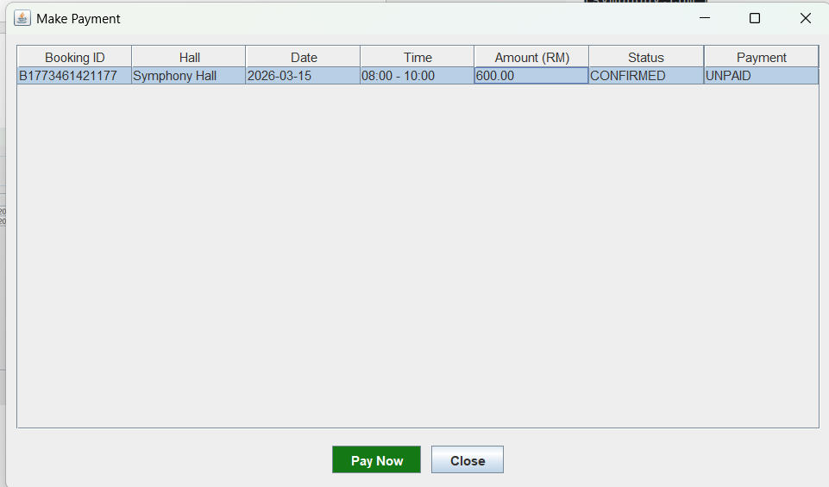
3.5 Customer Interface
Customer Dashboard
Customer Features
• Browse available halls
• Select event date/time (8AM-6PM)
• Automatic total calculation
• View booking history
• Cancel eligible bookings
• Multiple payment methods
• Report issues
• Update profile

Slide 18
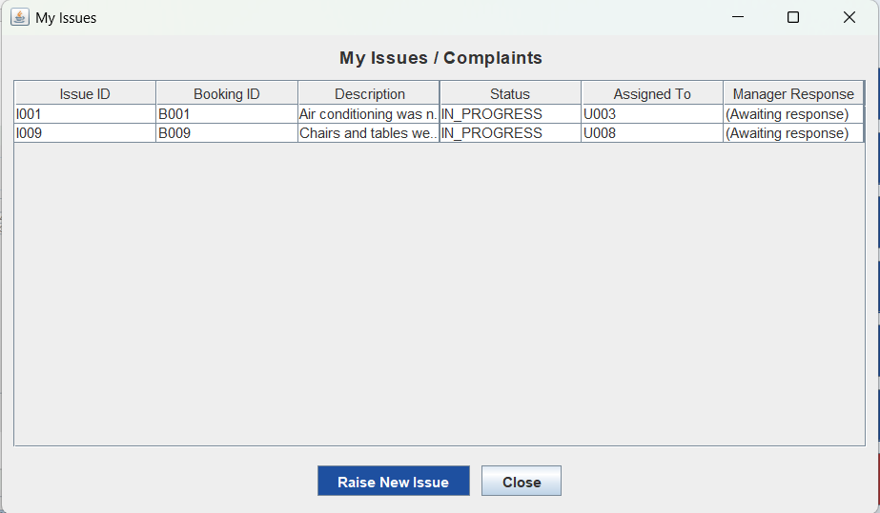
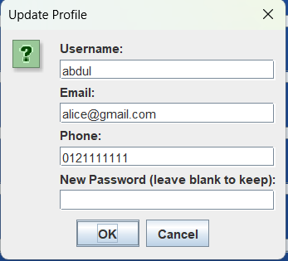
3.5 Customer Interface
Customer Dashboard

Slide 19
04
Object-Oriented
Concepts
Implementation and Justification of OOP Principles

Slide 20
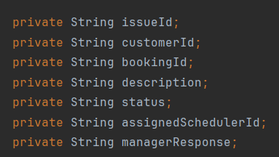
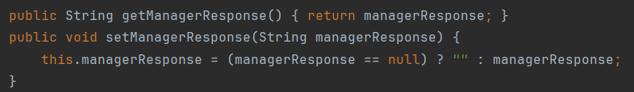
4.1 Encapsulation
Data Hiding and Controlled Access
Definition
Justification
Encapsulation is an object-oriented principle of hiding data in an object by making fields private and providing controlled access through public getter and setter methods.
Data Protection
Safeguards crucial information such as user passwords and financial amounts from unauthorized manipulation
Code Implementation
Controlled Access
customerPassword remains protected with getPassword() and setPassword()
Validation Logic
setManagerResponse() includes null-check, demonstrating setters can enforce data rules
Data Integrity
Ensures data integrity across all .txt file operations managed by FileManager

Slide 21
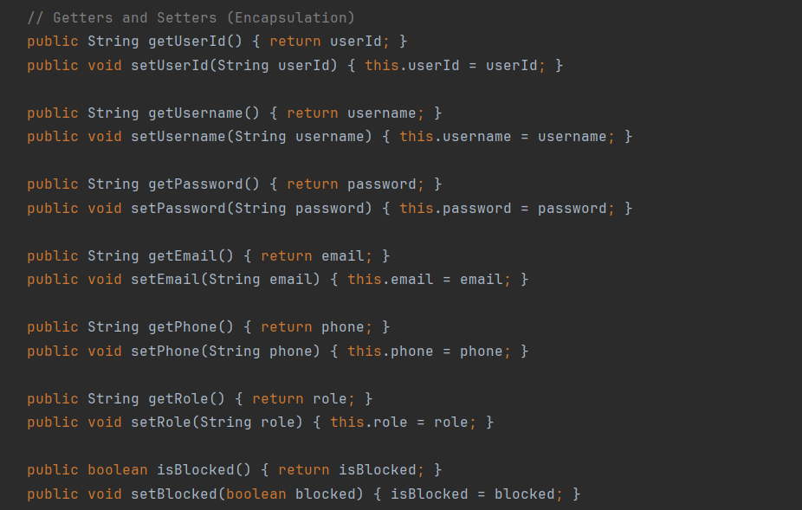
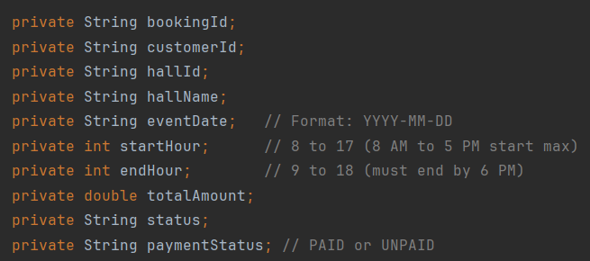
4.1 Encapsulation
Data Hiding and Controlled Access

Slide 22
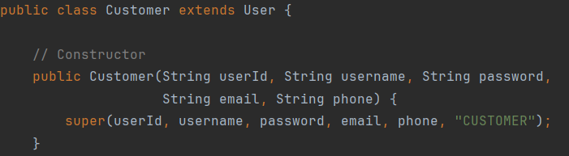
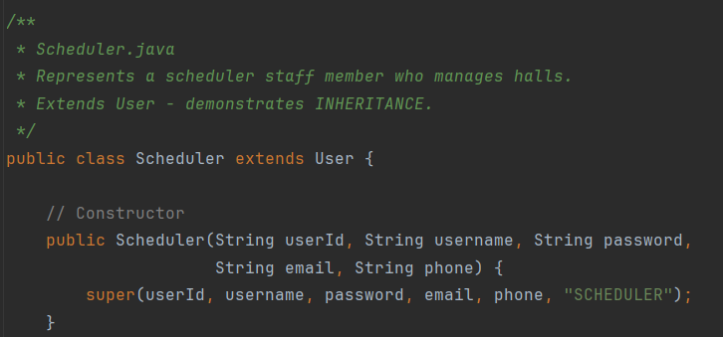
4.2 Inheritance
Code Reuse and "Is-A" Relationships
Definition
Justification
Inheritance allows a subclass to acquire attributes and methods of a superclass, establishing "is-a" relationships and enabling code reuse.
Eliminates Redundancy
Without inheritance, common fields (login credentials, block status) and methods ( toCSV() ) would be duplicated across all four user classes
Code Implementation
Unified Processing
FileManager can iterate through List and call toCSV() on each user regardless of actual role
Extensibility
New user roles can be added by simply extending User class without modifying existing code
Key Benefit: All subclasses inherit toCSV() method from User, enabling uniform CSV serialization across all user types through a shared User reference

Slide 23
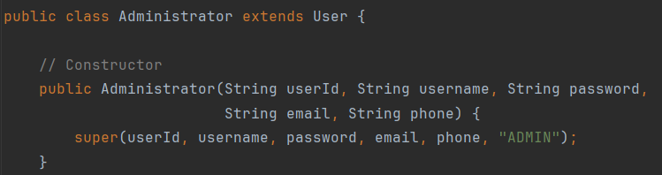
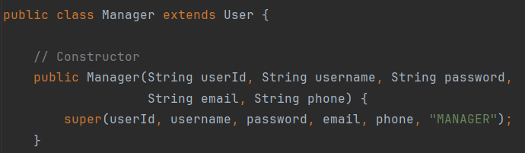
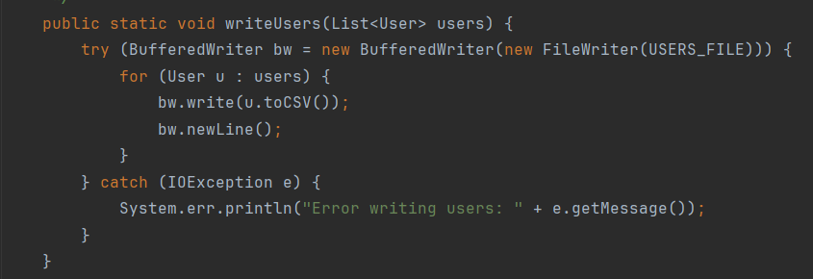
4.2 Inheritance
Code Reuse and "Is-A" Relationships

Slide 24

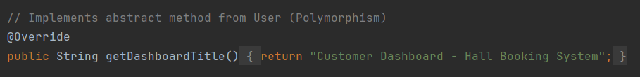
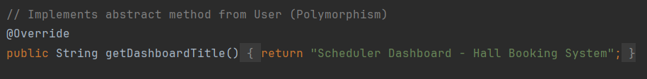
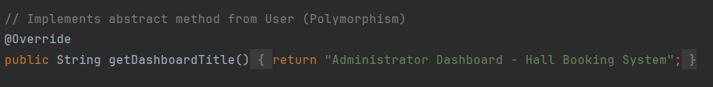
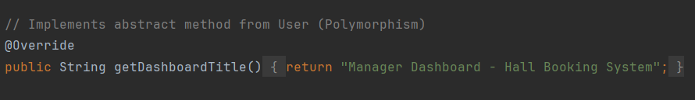
4.3 Polymorphism
Runtime Behavior and Method Overriding
Definition
Justification
Polymorphism enables the same method call to have different behaviors at runtime based on the actual object type, allowing method overriding.
Flexible Login System
Login system works with a single User reference without knowing the specific type until runtime
Code Implementation
Universal Method Calls
Methods like isBlocked() and getRole() work regardless of whether it's a Customer, Scheduler, Administrator, or Manager object
Easy Role Addition
If a new role is added, only need to extend with overridden getDashboardTitle() method and new case in switch statement; login logic remains untouched
Runtime Polymorphism: The actual object's method implementation is invoked based on the object's runtime type, not the reference type

Slide 25
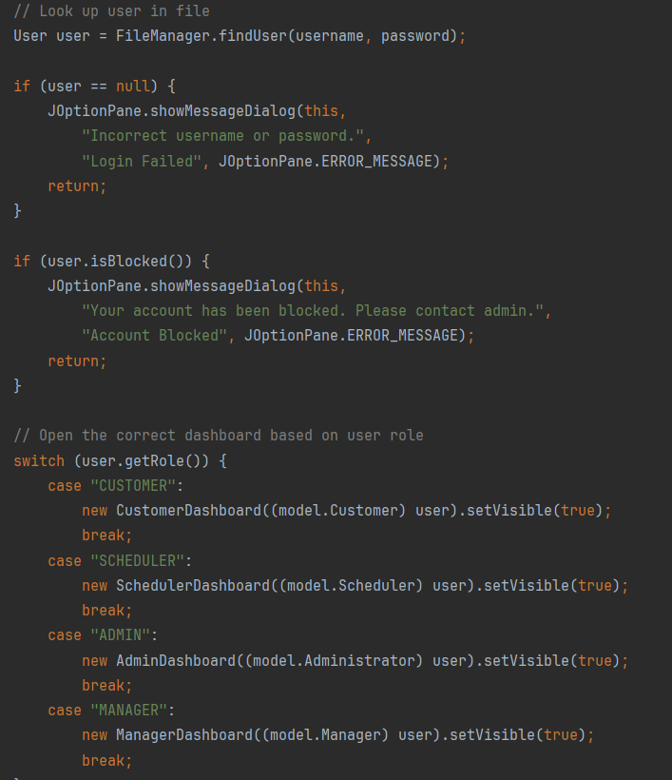
4.3 Polymorphism
Runtime Behavior and Method Overriding

Slide 26
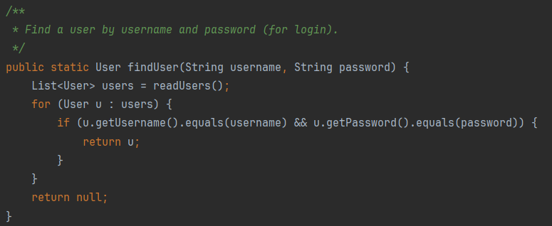
4.4 Abstraction
Hiding Implementation Details
Definition
Justification
Abstraction hides implementation details and shows only the relevant exposed parts to the outside world, achieved through the abstract User class and the utility class FileManager.
Contract Definition
Abstract User class defines the contract where each user type implements getDashboardTitle() , while hiding internal field structure
Code Implementation
Prevent Direct Instantiation
User cannot be directly instantiated, ensuring all user objects in the system are always concrete role-specific subclasses
Data Layer Abstraction
FileManager class abstracts the entire data layer; GUI classes treat it as a common interface for file operations
Storage Independence
GUI classes call FileManager.readUsers() or FileManager.writeBookings() without worrying about file paths, CSV splitting, BufferedReader, or IOException handling
Key Advantage: If storage method changes from .txt files to database, only FileManager needs modification, not each GUI class

Slide 27
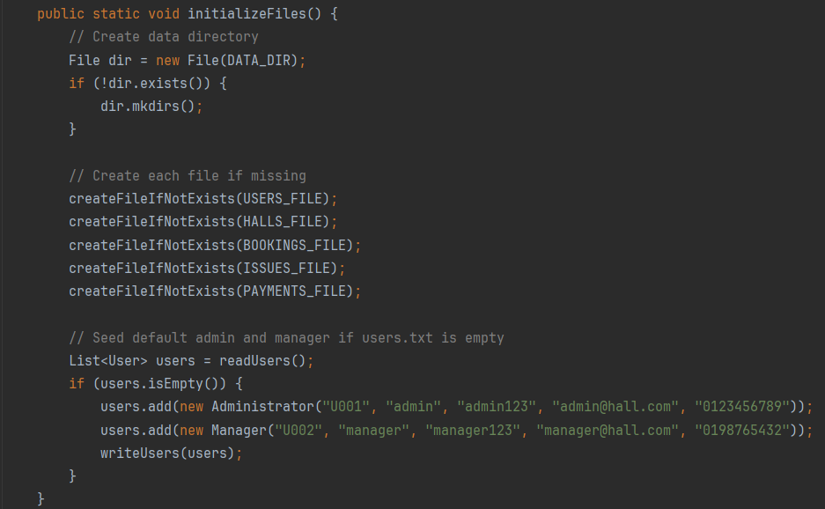
4.4 Abstraction
Hiding Implementation Details

Slide 28

05
Additional Features
Enhanced Functionality Beyond Requirements

Slide 29
5.1 Enhanced Functionality
Implemented Additional Features
Booking Report by Administrator
Extended Issue Status Tracking
Displays report of all booked events with confirmed/canceled counts and total revenue, providing management summary within application
Issues support five different statuses: OPEN, ASSIGNED, IN_PROGRESS, DONE, CLOSED, CANCELLED for detailed resolution tracking
Auto-Seeded Default Accounts
Timestamp-Based ID Generation
initializeFiles() method checks if users.txt is empty on first launch and auto-seeds default Administrator and Manager accounts for immediate system readiness
FileManager.generateId() uses System.currentTimeMillis() to generate unique IDs across all entities, avoiding collisions
Multiple Payment Methods
Color-Coded Dashboards
Payment class supports three payment modes: Cash, Card, Online Transfer defined as constants METHOD_CASH , METHOD_CARD , METHOD_ONLINE
Each role has distinct colors: blue (Customer), green (Scheduler), orange (Administrator) for immediate visual separation
Manager Response on Issues
Input Validation
Issue class includes managerResponse field for direct Manager response to Customer issues beyond Scheduler assignment
All forms validate empty fields, duplicate usernames, and invalid formats. System includes JOptionPane error dialogs to guide users when validation fails

Slide 30

06
Limitations and
Conclusion
System Constraints and Final Assessment

Slide 31
6.1 System Limitations
Identified Constraints
Plain Text Storage Risks
No Concurrent Access Support
.txt files lack transactional safety; crashes during writes can corrupt data files
Single-user application; multiple instances accessing shared .txt files may cause race conditions
Solution: Database management system with atomic transactions and rollback protection
Solution: Database with transaction locking mechanisms
Password Encryption
Limited Reporting
Passwords stored plainly in users.txt file
Solution: BCrypt or strong hashing algorithms for production systems
Manager sales dashboard provides simple revenue summaries without export options
Solution: PDF/Excel export and trend analysis charts
Booking Conflict Detection
No Email Notifications
System allows simultaneous bookings for same hall at same time
Solution: Logic to check slot availability at time of booking
Live systems should send email confirmations for bookings, payments, and issue reports
Solution: Integration with email service providers

Slide 32
6.2 Conclusion
Project Assessment
OOP Principles Demonstrated
The Hall Booking Management System is a fully functional Java GUI application demonstrating all four OOP principles: encapsulation, inheritance, polymorphism, and abstraction.
Class Hierarchy
Data Layer Abstraction
Maintains a hierarchy with abstract base class User preventing duplication across four user roles and providing a clean, extensible structure.
FileManager utility class provides well-abstracted data layer, making GUI code independent of storage mechanism.
Requirements Fulfilled
Core Requirements:
Additional Features:
✓ All role-specific dashboards implemented
✓ Richer issue tracking environment
✓ Minimum assignment requirements met
✓ Manager response capability
✓ Four user roles with distinct features
✓ Multiple payment methods
✓ Auto-seeding of default accounts
The project achieved its objective by designing and implementing an Object-Oriented System using Java

Slide 33
References
Academic References
Bloch, J. (2018). Effective Java. Addison-Wesley.
Deitel, P., & Deitel, Harvey. (2020). Java: How to Program, Early Objects. Pearson.
JetBrains. (2024). IntelliJ IDEA: The Java IDE for Professional Developers. JetBrains.
Oracle Corporation. (2024). Java SE 8 Documentation. Oracle.
Oracle Corporation. (2024). Java Swing Tutorial. Oracle.

Slide 34
Thank You
Questions & Discussion
Java Swing Application
Hall Symphony Inc
2026

